Slide 1
Bev’s Bakery
Web Design RFP
Adrian Grimm
15 March 2020 • WDD229

Slide 2
URL and Hosting
BevsBakery.com
Available for purchase for $8.88/yr from namecheap.com.
A search returns a Facebook page but no other online presence.
Simple, effective URL is easy to remember and highlights the name of the business.
Hosted on HostGator
Monthly cost of $10.95
Guaranteed 99.9% Uptime
Unmetered storage and bandwidth
Unlimited email and FTP accounts
Free SSL Certification
Secure databases with password protection

Slide 3

Color Palette
I chose this palette for bright and vibrant colors and stark contrast between elements.
Blue is the most-preferred color and represents security and trust in a brand. This shade was selected for whimsical vibrance.
Green is the second most-preferred color, easily processed by the eye, and represents tranquility and health.
Red shows passion and urgency and is often used to stimulate the hunger impulse to promote the purchase of food, in this case baked goods.

Slide 4

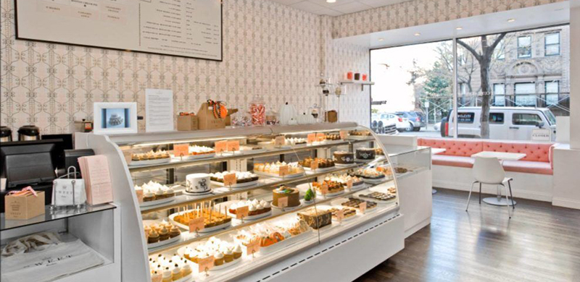
Browser
https://www.bevsbakery.com
Welcome to Bev’s Bakery!

Slide 5
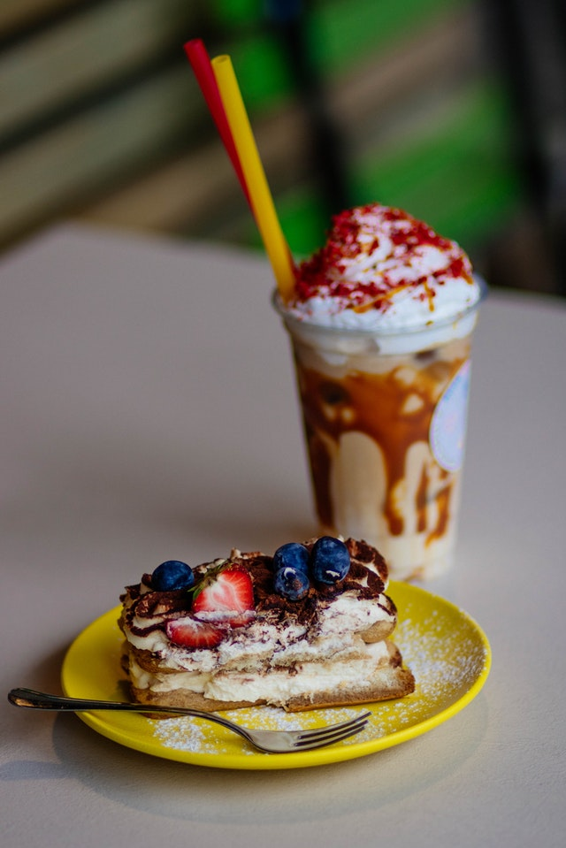
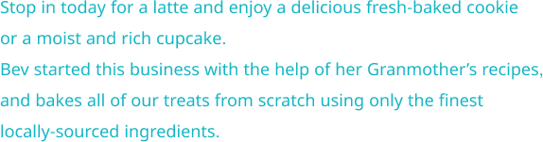

Browser
https://www.bevsbakery.com/#treats

Slide 6

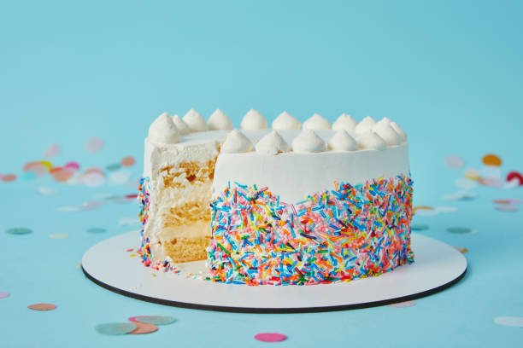
Browser
https://www.bevsbakery.com/#specialOrder

Slide 7
Home Page
Each slide represents an anchored section on the home page. They are represented this way to show content.
The navbar at the top is “sticky” and will still show as the user scrolls through the page.
Sample images shown to represent actual content.

Slide 8
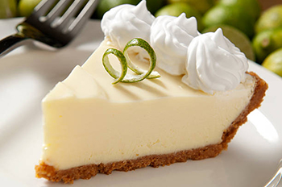
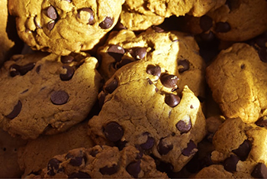
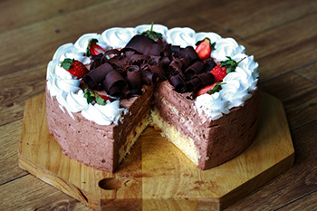
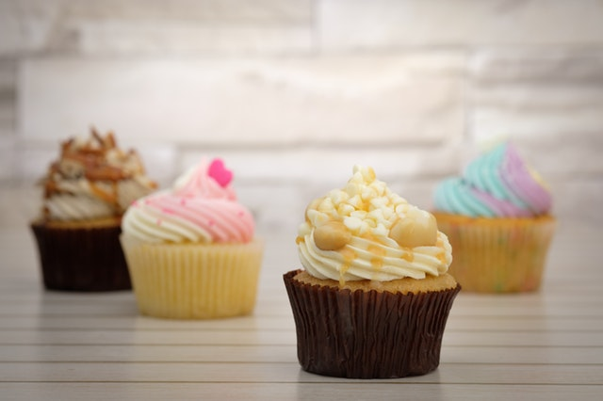
Browser
https://www.bevsbakery.com/aboutUs.html
For more than 25 years, Bev Bailey has been perfecting her craft. As a child, her fondest memories were of her time in the kitchen with her Grandmother. She taught Bev recipes to bake cakes from scratch. When Bev’s children were young, she wanted to help raise money for their school, so she hosted a bake sale. Most of the bake sale items were made by her and the other parents absolutely raved at how delicious her baked goods were. Bev hosted these bake sales for 10 years. All the while, her parents suggested she open her own bakery, and finally, Bev’s Bakery was a reality! More than only cakes, Bev’s Bakery has a wide supply of cookies and cupcakes. Bev also bakes cakes and cupcakes for special occasions. Or if you’re in the mood for a delectable dessert, come in and have a seat!

Slide 9
Website Accessibility
Accessibility is required by law and helps people with disabilities. In this website, we will ensure accessible compliance:
Semantic HTML elements, ensuring keyboard navigation through sections on the page.
Alt-text for all images used throughout the website.
Color contrast set at acceptable ratio levels.
Easily read sans-serif font families that can be enlarged without disrupting web design.
Descriptive link text on hover.

Slide 10
Responsive Design
Responsive Design principles are very important. Most web users will see the website on their phone. Therefore, it is important to create web content that flows smoothly from mobile display to larger display properties.
This customer has requested the website be built with WordPress for ease of daily maintenance. WordPress already has responsive design built into its template. No further action is needed.
If the customer has special page requests that will be compiled as a static page, CSS properties will be implemented: flexbox and grid, along with responsive or resized images and the semantic HTML elements already mentioned.

